Slide 1
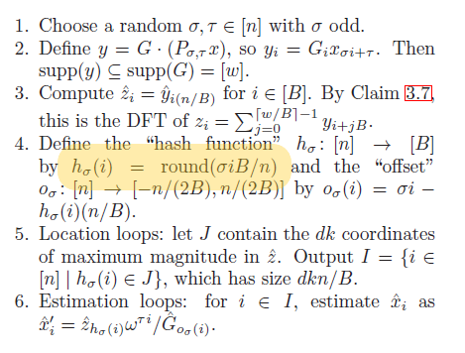
Error Found
1) The hash functions works for only sigma = 1. Any other random value will not result in a proper mapping

Slide 2
RESULTS

Slide 3
USING ALREADY PRESENT WINDOW FUNCTIONS

Slide 4
USING BIGBAND

Slide 5
MULTIPLE TIMES CONVOLUTION

